Slide 1
Evaluation and improvement of a dual-channel method for the detection and quantification of high-temperature events on FireBIRD data
Penghua Li, October 04, 2017

Slide 2
Contents
Introduction of MITIP, an atmospheric correction and image processing method
Short description of MITIP
Data preparation and pre-processing
Outcomes of the MITIP
Validation and improvement of the MITIP
Results comparison with MODIS SST and calibration
Transferability test (SST)
Results comparison with MODIS LST and calibration
Transferability test (LST)
Analysis of high-temperature events
High-temperature events
Comparison with the results of Zhukov’s algorithm
Conclusion and outlook

Slide 3
1. Introduction of MITIP, an atmospheric correction and image processing method
The MITIP method is an atmospheric correction and image processing method developed by Dr.Rudolf at DLR, which is used for processing the thermal remote sensing imageries of the FireBIRD satellite.
MITIP firstly performs atmospheric corrections for the TET-1 imagery based on the water vapor column and elevation to get the ground surface radiance and temperature. Afterwards, a dual channel method is used to detect and characterize sub-pixel temperatures of hot pixels.

Slide 4
1. 2 Data preparation and pre-processing
Required input for MITIP:
TET-1 scene with two bands: MIR as the first band, TIR as the second band;
Water vapor file. Here we use MODIS water vapor products;
Digital Elevation Models (DEM). ASTER Global Elevation map is used;
Emissivity maps. Here we use the ASTER Global Emissivity Database;
All the above data is downloaded from the NASA’s websites. Most of them need to be converted to the GeoTIFF format firstly. According to the requirement of the MITIP, the input data should be 1) overlapped and 2) share the same numbers of rows and columns and 3) have same pixel size.
Here Python and GDAL are used to do the pre-processng.
All input files and converted to the GeoTIFF format and reprojected into an appropriate UTM zone;
All input files are resampling to pixel size 150 * 150;
The TET-1 scene is used as mask to clip other imageries to ensure they are of same size.

Slide 5
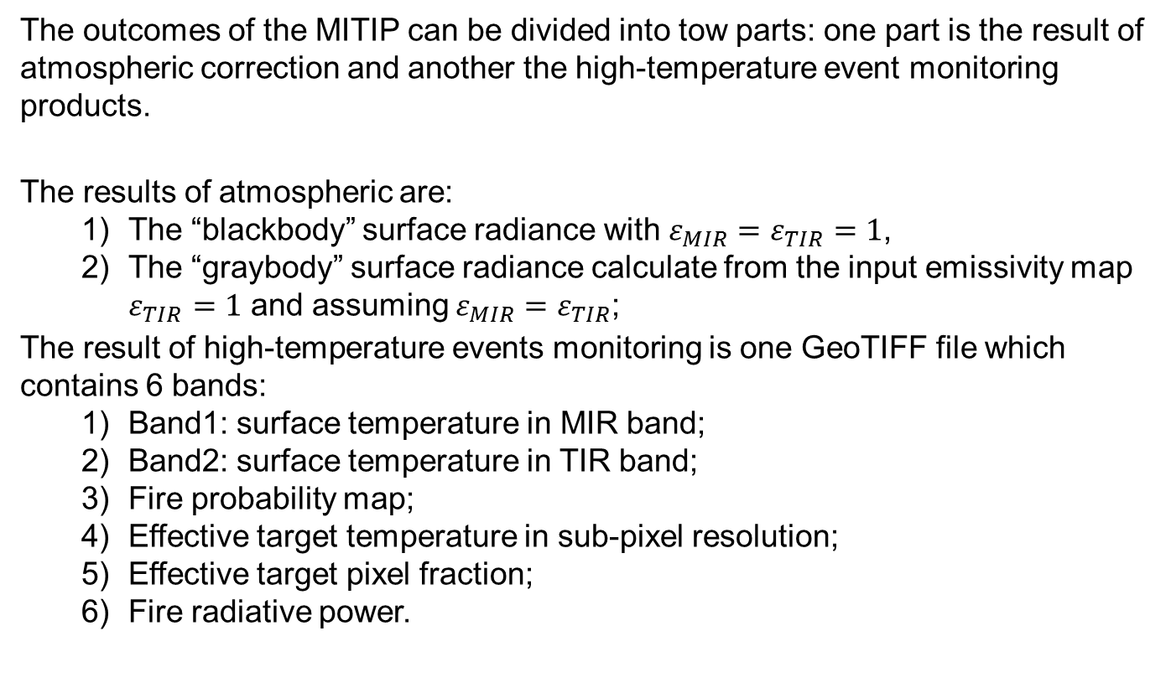
1. 3 Outcomes of the MITIP
The outcomes of the MITIP can be divided into tow parts: one part is the result of atmospheric correction and another the high-temperature event monitoring products.
The results of atmospheric are:
The “blackbody” surface radiance with $ε_{MIR}=ε_{TIR}=1$,
The “graybody” surface radiance calculate from the input emissivity map $ε_{TIR}=1$ and assuming $ε_{MIR}=ε_{TIR}$;
The result of high-temperature events monitoring is one GeoTIFF file which contains 6 bands:
Band1: surface temperature in MIR band;
Band2: surface temperature in TIR band;
Fire probability map;
Effective target temperature in sub-pixel resolution;
Effective target pixel fraction;
Fire radiative power.

Slide 6
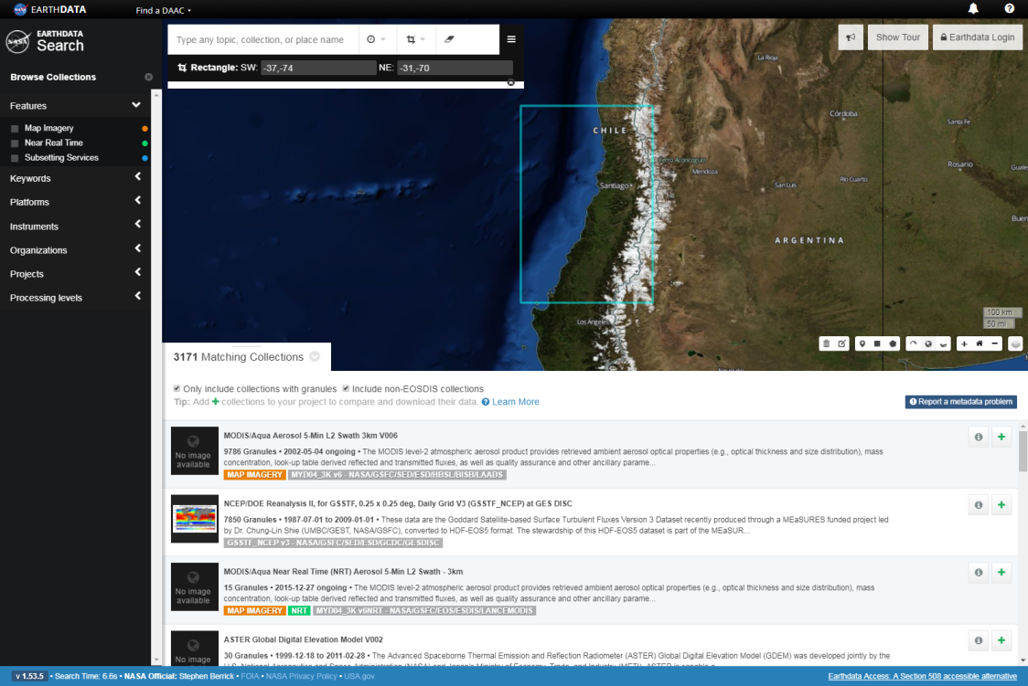
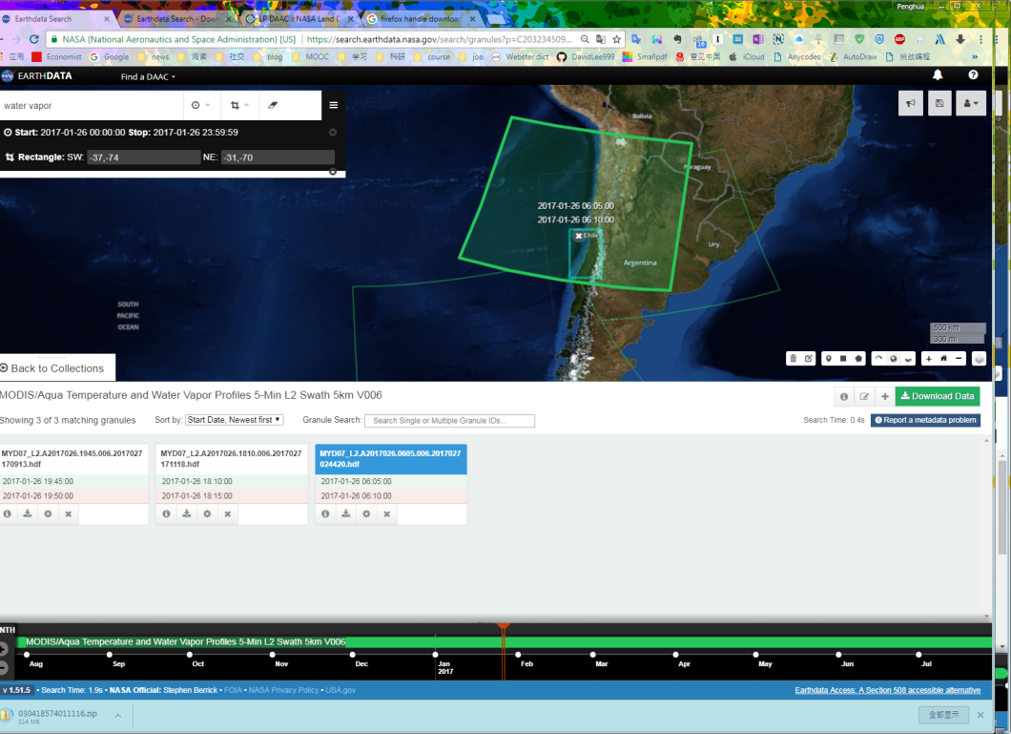
1. Introduction of MITIP, an atmospheric correction and image processing method
1. Download the auxillary data from https://search.earthdata.nasa.gov
Firstly, the location and size of area of interest should be determined;
For MODIS water vapour, the scene which is closest to the time of the TET scene should be selected.

Slide 7
1. Introduction of MITIP, an atmospheric correction and image processing method
2. Pre-processing of the data
2.1 Pre-processing of the MODIS water vapour data
The MODIS water vapour file must be processed with the SNAP Toolbox.
Required input:
File name;
Desired band‘s name;
Crs: EPSG code (UTM zone);
Output file name and format (GeoTiff usually)
After processing, you can load the data to QGIS/ArcGIS and check if the results are available for the TET area. And then Extract only the water vapour band from the result file, which might contain latitude and longitude as well.

Slide 8
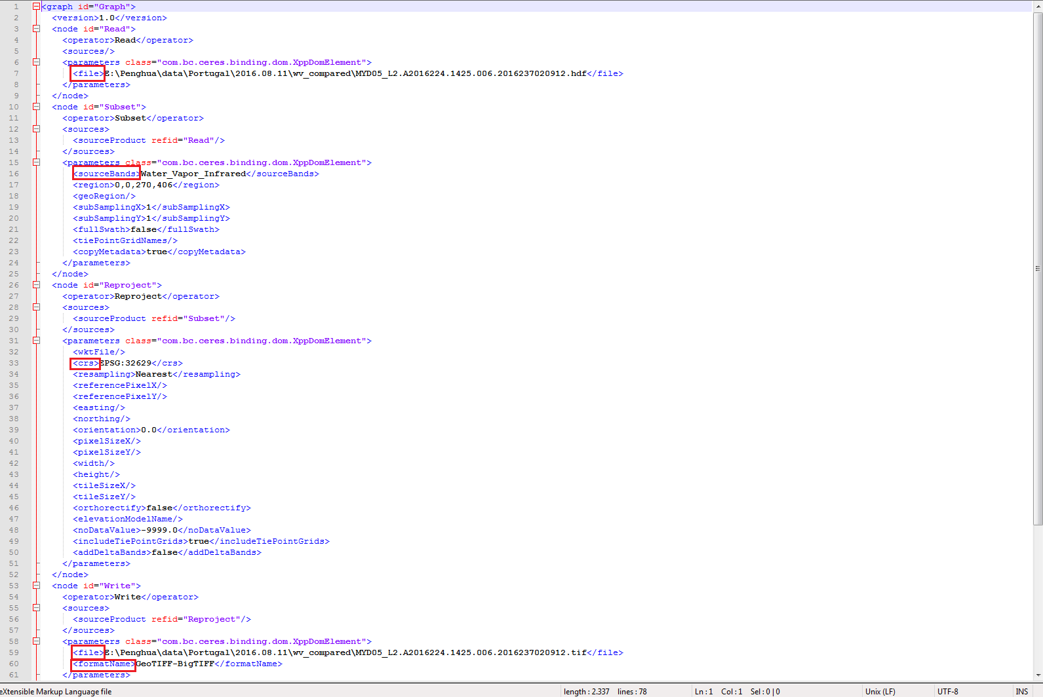
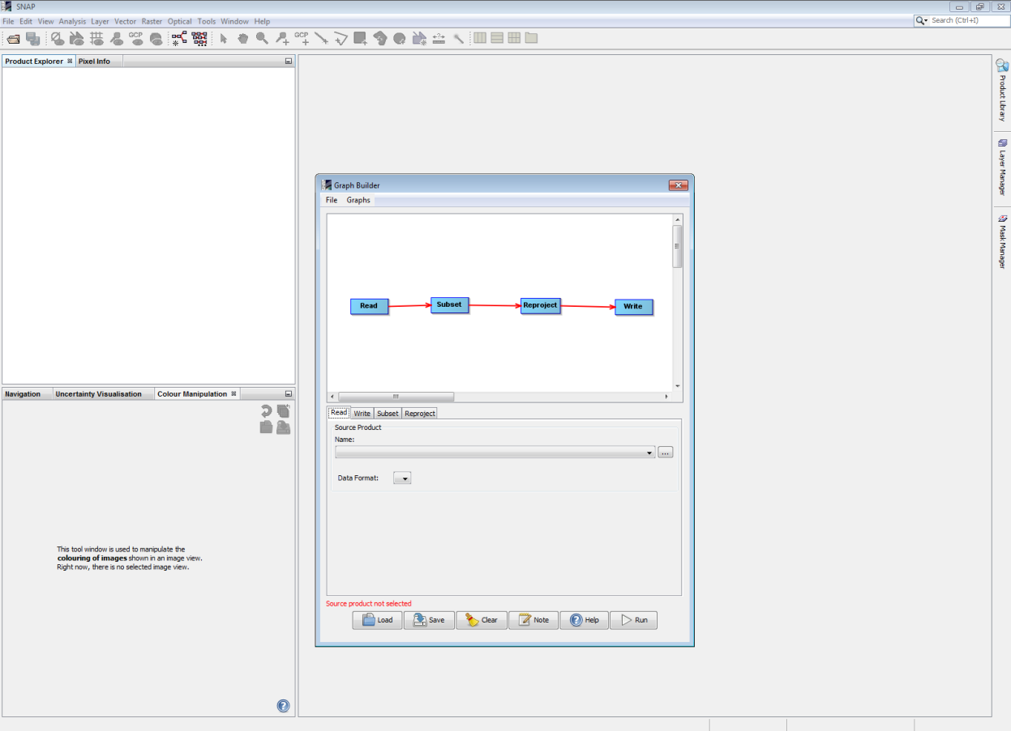
1. Introduction of MITIP, an atmospheric correction and image processing method
gpt E:\Penghua\Programming\Master_thesis\pre_processing\bat\HDF2GTiff.xml

Slide 9
1. Introduction of MITIP, an atmospheric correction and image processing method
All code files are given in
\\eocopfs01.intra.dlr.de\FireBIRD\Data\masterthesis_penghua\TiddlyWikiPenghua\TiddlyWikiPenghua.html
or in
\\eocopfs01.intra.dlr.de\FireBIRD\Data\masterthesis_penghua\Pre-processing\Description_of_the_Process_Steps.htm

Slide 10
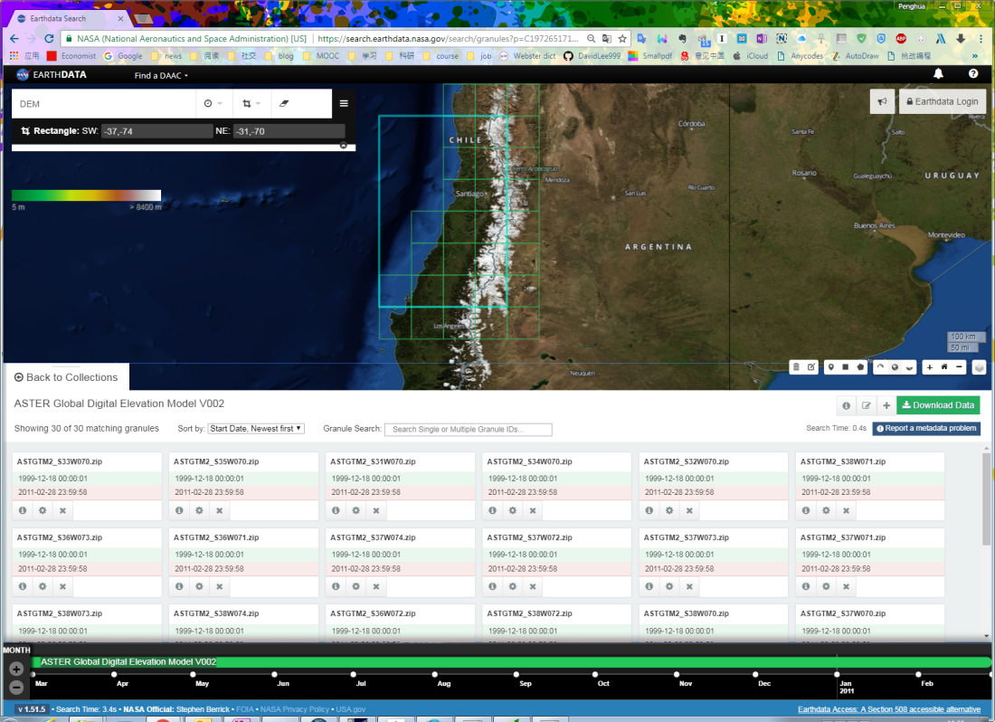
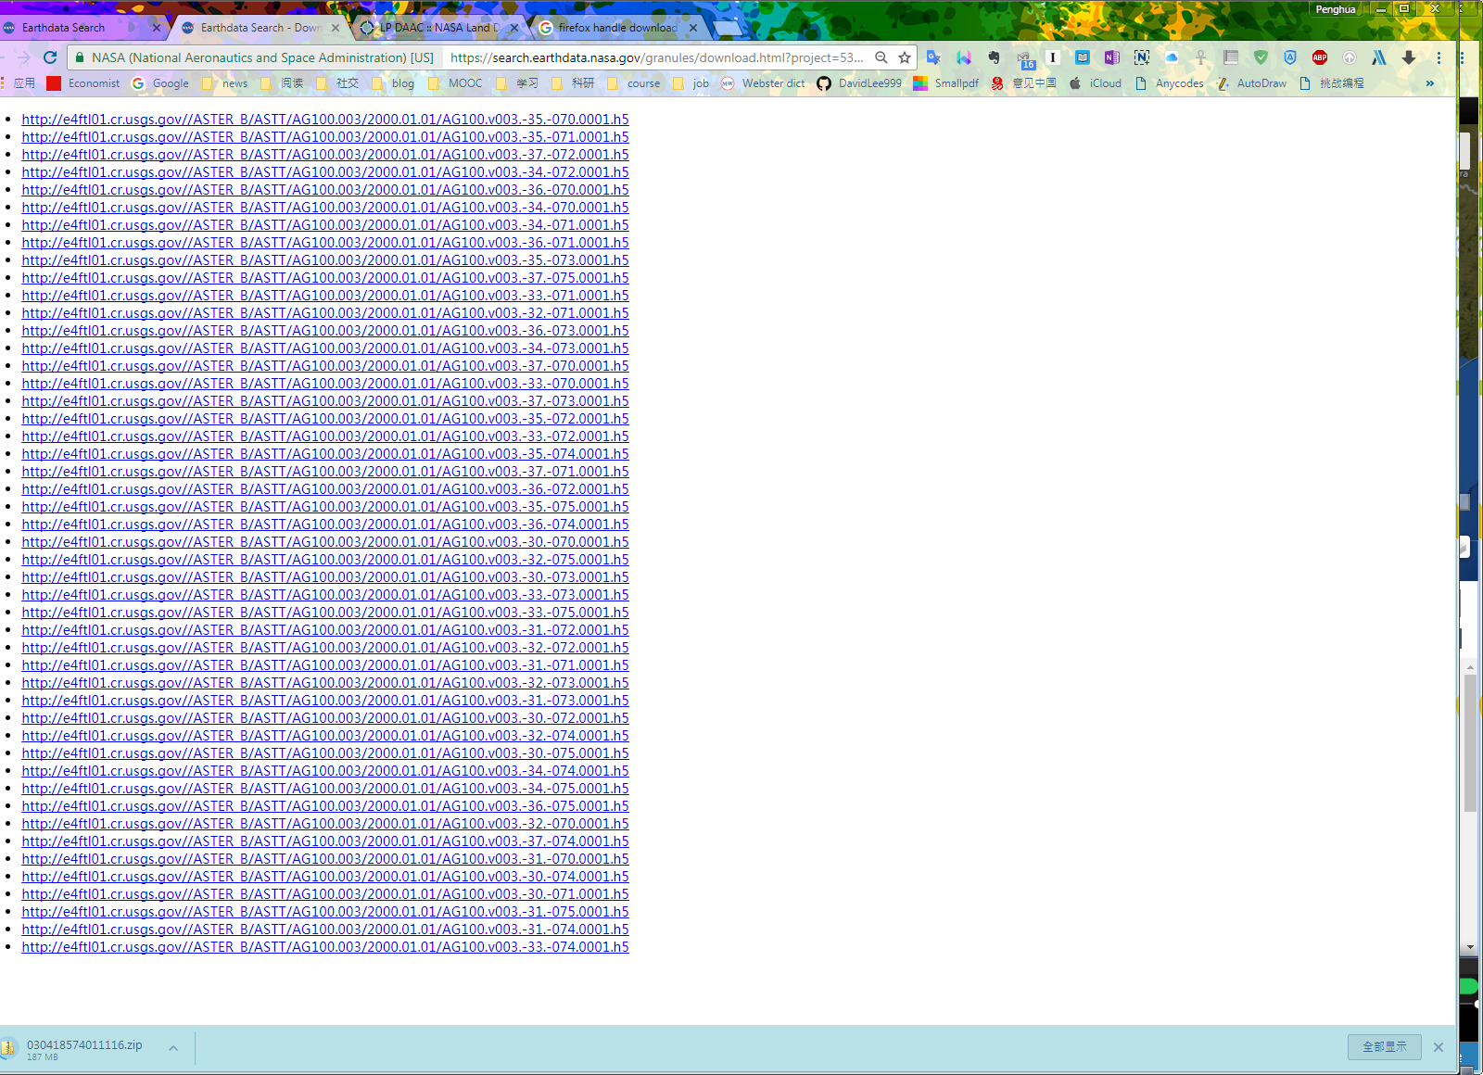
1. Introduction of MITIP, an atmospheric correction and image processing method
2.2 Pre-Processing of the ASTER DEM
The ASTER DEM is of little square size.
One TET scene covers lots of ASTER DEM file.
Download them all.

Slide 11
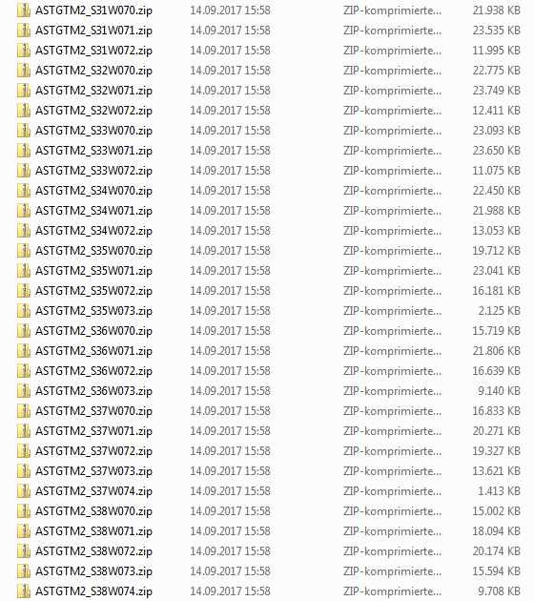
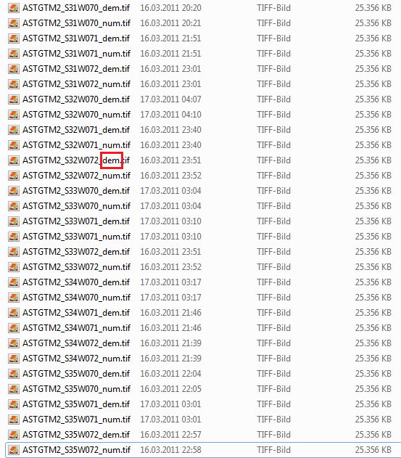
1. Introduction of MITIP, an atmospheric correction and image processing method
After downloading, you need to unzip all the file first.

Slide 12
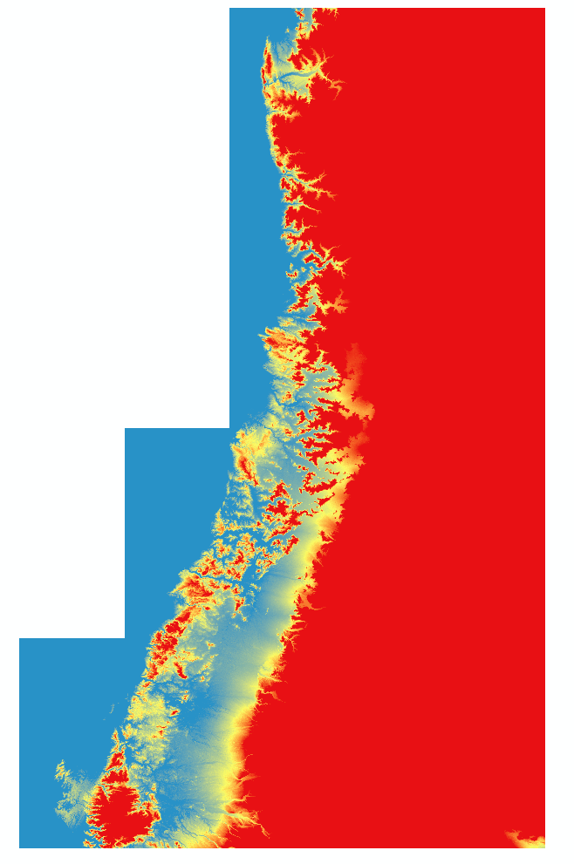
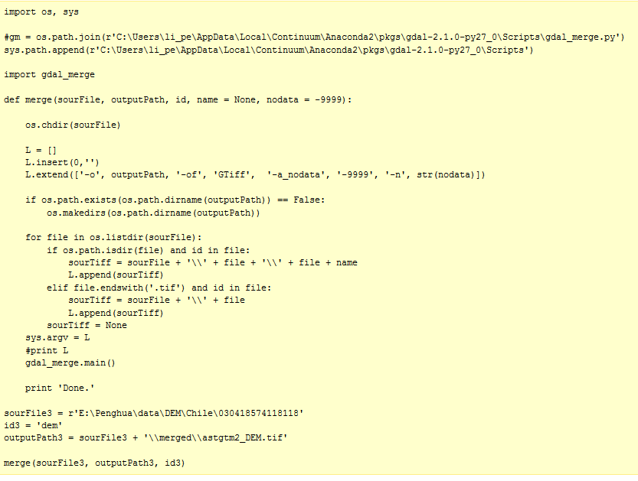
1. Introduction of MITIP, an atmospheric correction and image processing method
Then, Merge the single little DEMS to a large DEM file. Name it as aster2_DEM.tif for example. (The Python code is given in the Kopierer).

Slide 13
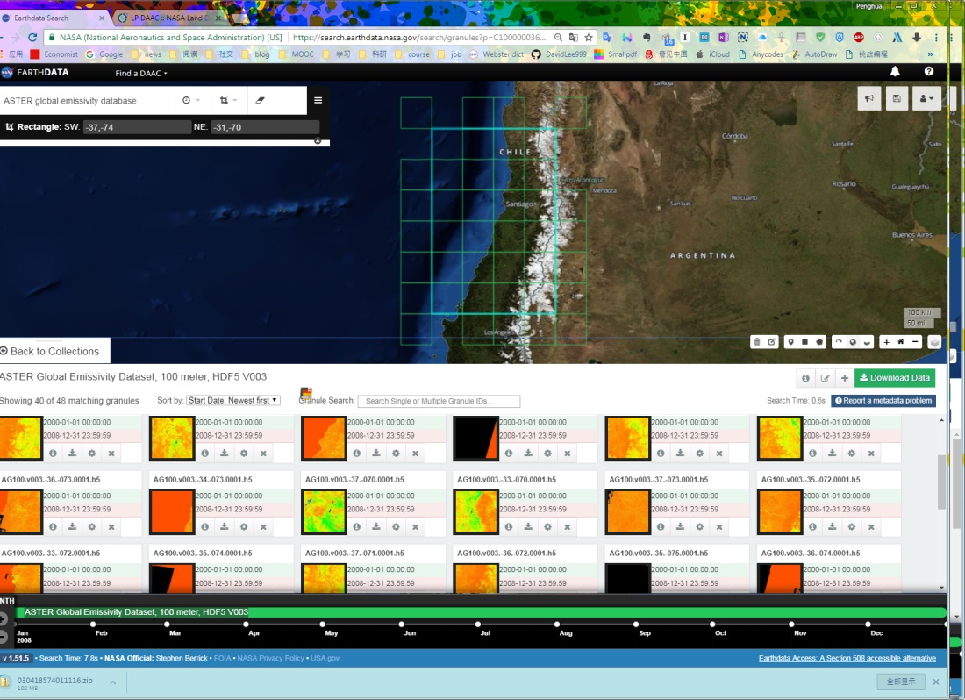
1. Introduction of MITIP, an atmospheric correction and image processing method
2.3 Pre-Processing of the ASTER Global Emissivity Database
Same as The ASTER DEM file, ASTER Global Emissivity Database is of little square size.

Slide 14
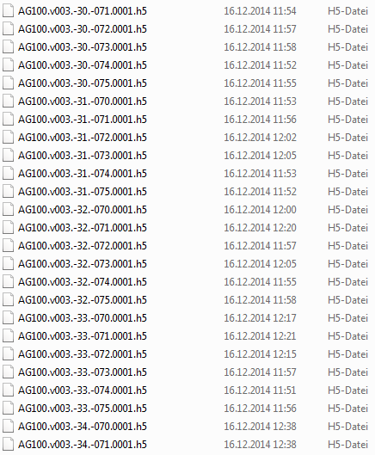
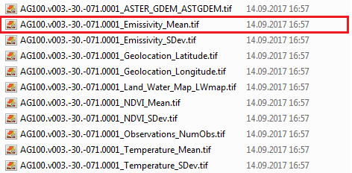
1. Introduction of MITIP, an atmospheric correction and image processing method
Unzip the file frstly as well.
However, the ASTER GED is of format HDF, so processing of it should be done according to the official document. As well, the python code is in the Kopierer.
Merge the single Emissivity files to emissivity_map_Chile.tif. Same Python code as before.
Extract the 2nd band (emissivity for Band 11 - 8.6 μm)

Slide 15
1. Introduction of MITIP, an atmospheric correction and image processing method
2.4 Reprojection all the file, including TET-1 scene, water vapour file, ASTER DEM and ASTER GED, to appropriate UTM zonr (EPSG:32719 for Chile for example) and Resampling to 150 x 150

Slide 16



1. Introduction of MITIP, an atmospheric correction and image processing method
2.5 Clipping the results to the extent of the TET-1 scene
Create an alpha channel using TET-1 imagery;
Create a shapefile from this alpha channel;
Clip the Aster DEM file with this clip shapefile;
Clip the Aster GED file with this clip shapefile;
Clip the MODIS water vapour file with this clip shapefile;
Do forget to clip the TET scenes with this clip shapefile

Slide 17
1. Introduction of MITIP, an atmospheric correction and image processing method
2.6 Finally, as required, by MITIP, MIR band imagery and TIR band imagery of TET-1 should be merged to one file with the first band MIR band.
If it is a day-time scene, then additional red band is required as well and should be the first band of merged file.

Slide 18
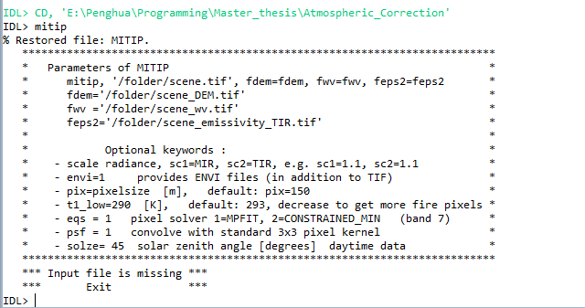
1. Introduction of MITIP, an atmospheric correction and image processing method
2.7 After all of the pre-processing above, now we are able to use MITIP.
Open IDL and locating to the the folder which contains mitip, typing mitip in the IDL console you will see:
Notes:
The meaning of each keyword has been stated before

Slide 19

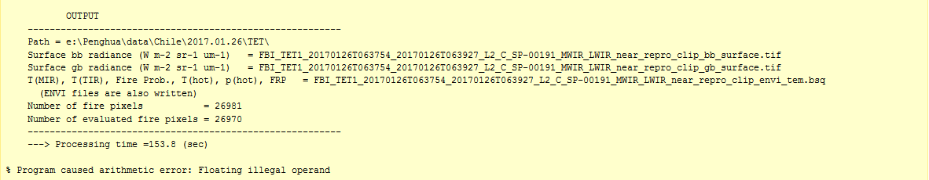
1. Introduction of MITIP, an atmospheric correction and image processing method
Sepcifying each required keyword with the correct path and file name to the corresponding file as showed bellow and push the return botton, MITIP start to process the data.
End marker: Until the IDL shows the information about the result and total processing time, the process is done
Notes:
The meaning of each keyword has been stated before

Slide 20
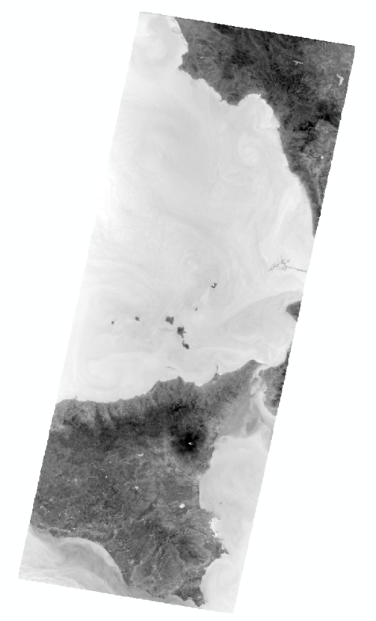
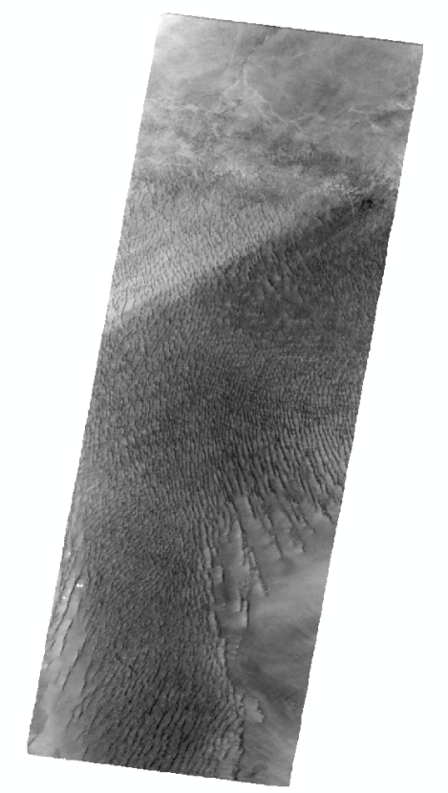
2. Validation and improvement of the MITIP
To see whether the temperature results derived from the MITIP is reliable or not, firstly we compare them with MODIS temperature products, namely MODIS Sea Surface Temperature (SST) and MODIS Land Surface Temperature, to see its performance under normal temperature environments.
Here we select two test sites whose imageries mainly covered by sea (Etna) and homogeneous landscape (Libya) respectively.
Etna:
Libya-1:

Slide 21
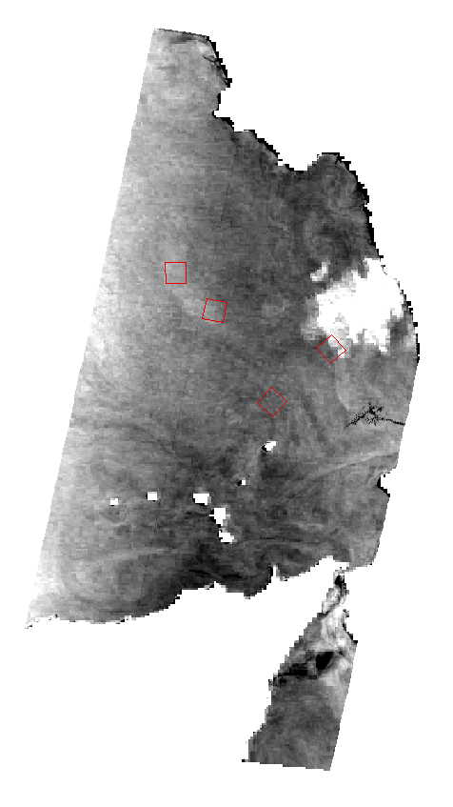
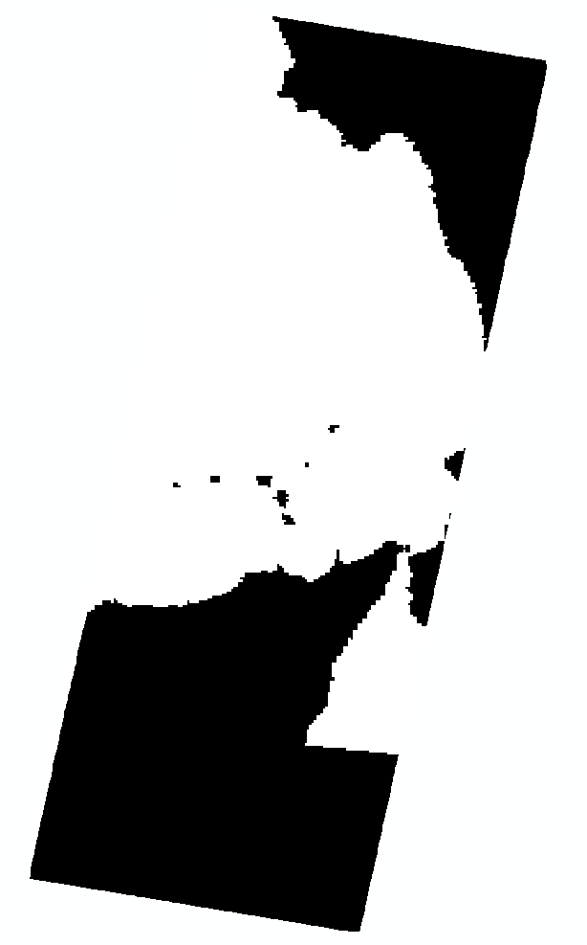
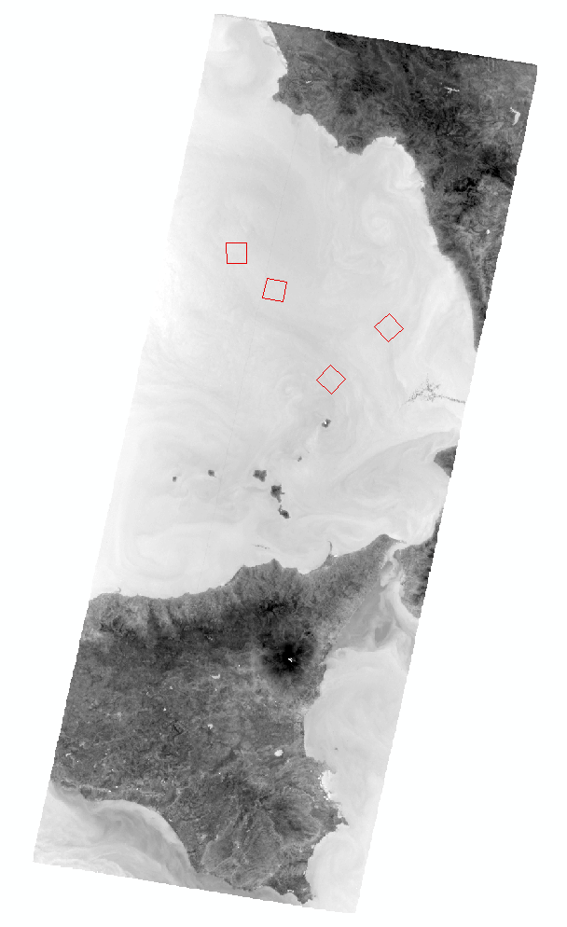
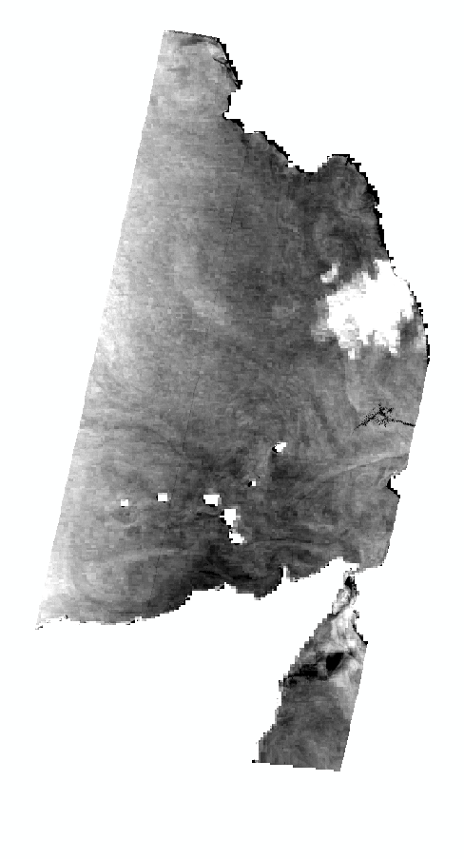
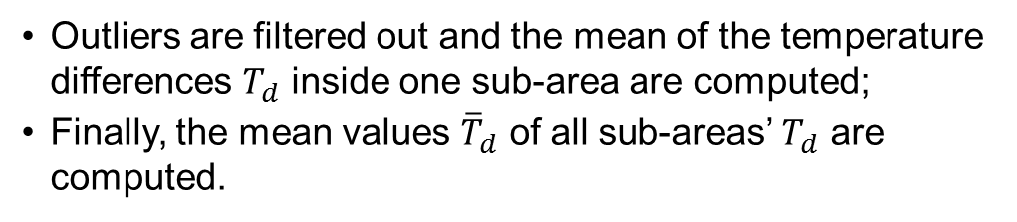
2. Validation and improvement of the MITIP
The comparisons are done as follows (Etna as example):
The MODIS temperature products are reprojected into the same projection as TET-1 imagery, then resampled into same pixel size and clip into the same size as TET-1 imagery.
The differences of the temperature between the MITIP temperature results and MODIS temperature products are computed through the whole imagery.
For each test site, several (3 – 5) sub-areas which are cloud-free and homogeneous inside for all scenes are selected.
Outliers are filtered out and the mean of the temperature differences $T_{d}$ inside one sub-area are computed;
Finally, the mean values ${\overline{T}}_{d}$ of all sub-areas’ $T_{d}$ are computed.

Slide 22
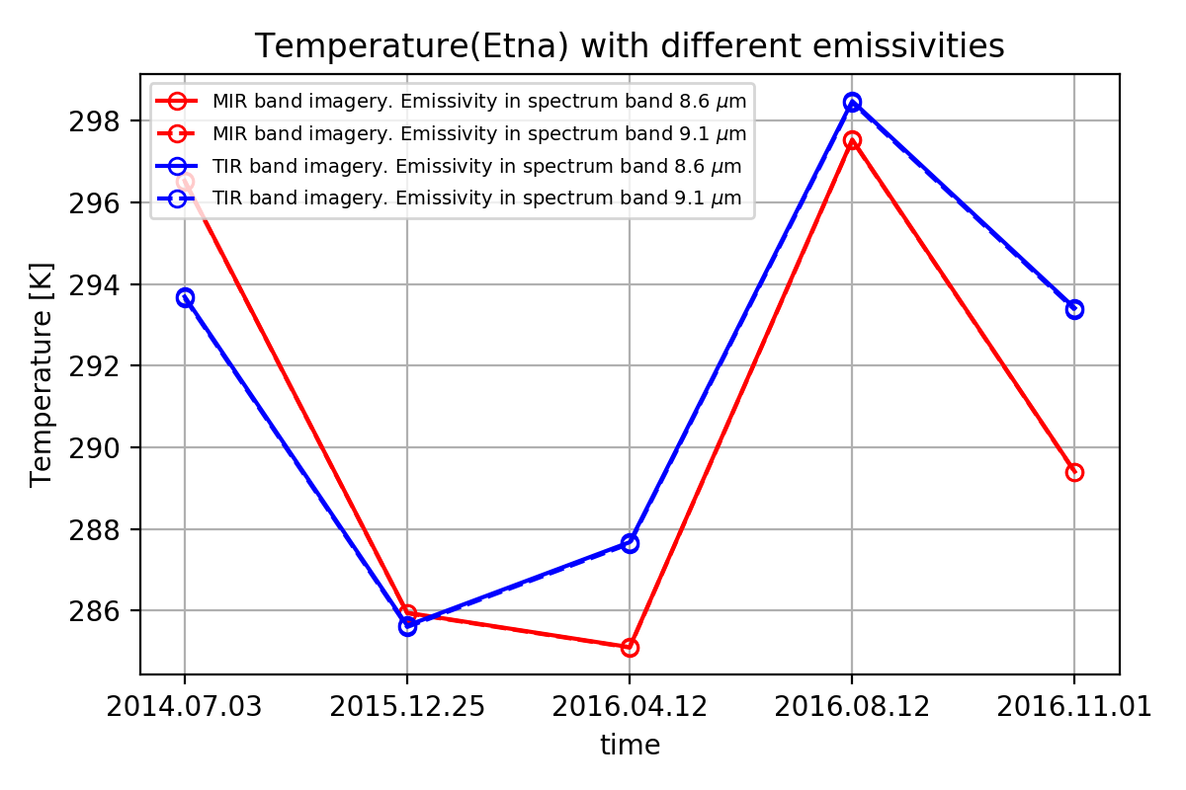
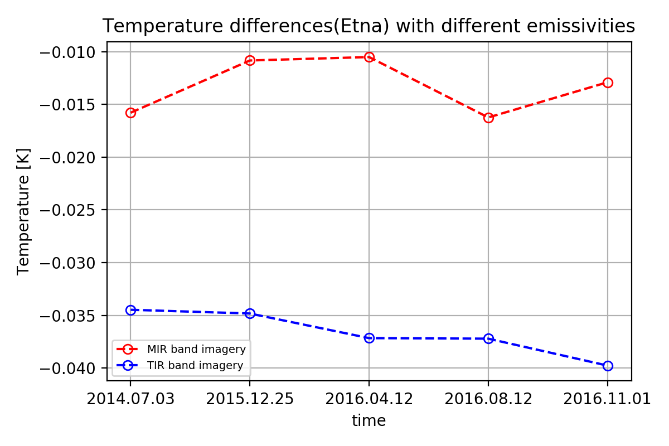
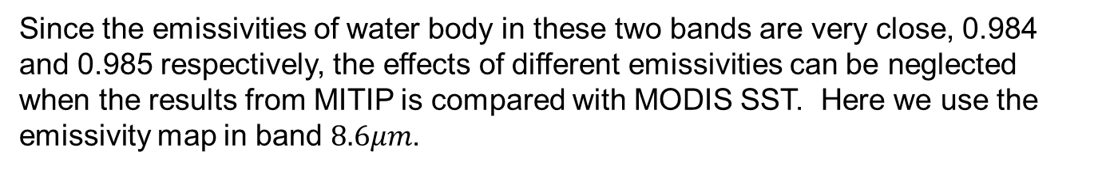
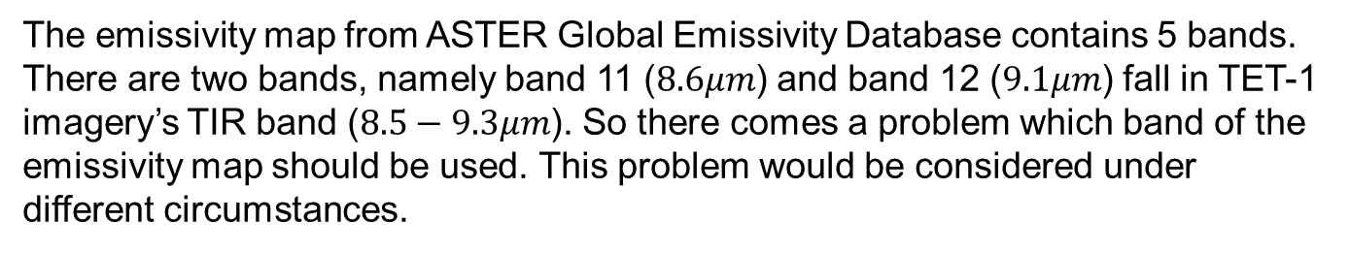
2.1 Results comparison with MODIS SST and calibration
The emissivity map from ASTER Global Emissivity Database contains 5 bands. There are two bands, namely band 11 ($8.6μm$) and band 12 ($9.1μm$) fall in TET-1 imagery’s TIR band ($8.5−9.3μm$). So there comes a problem which band of the emissivity map should be used. This problem would be considered under different circumstances.
Since the emissivities of water body in these two bands are very close, 0.984 and 0.985 respectively, the effects of different emissivities can be neglected when the results from MITIP is compared with MODIS SST. Here we use the emissivity map in band $8.6μm$.

Slide 23
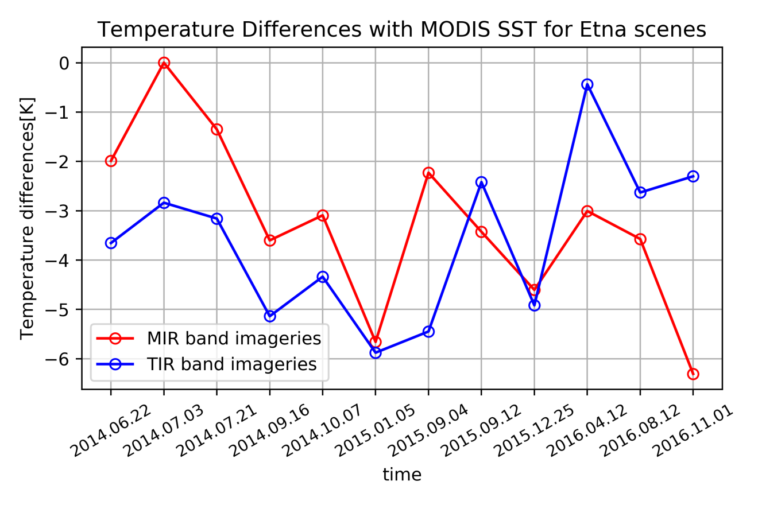
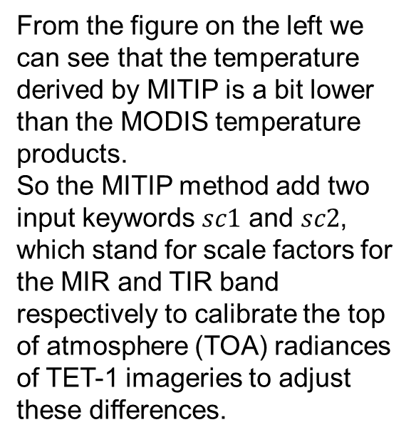
2.1 Results comparison with MODIS SST and calibration
Firstly, the temperature results from MITIP is compared with MODIS SST.
From the figure on the left we can see that the temperature derived by MITIP is a bit lower than the MODIS temperature products.
So the MITIP method add two input keywords $sc1$ and $sc2$, which stand for scale factors for the MIR and TIR band respectively to calibrate the top of atmosphere (TOA) radiances of TET-1 imageries to adjust these differences.

Slide 24
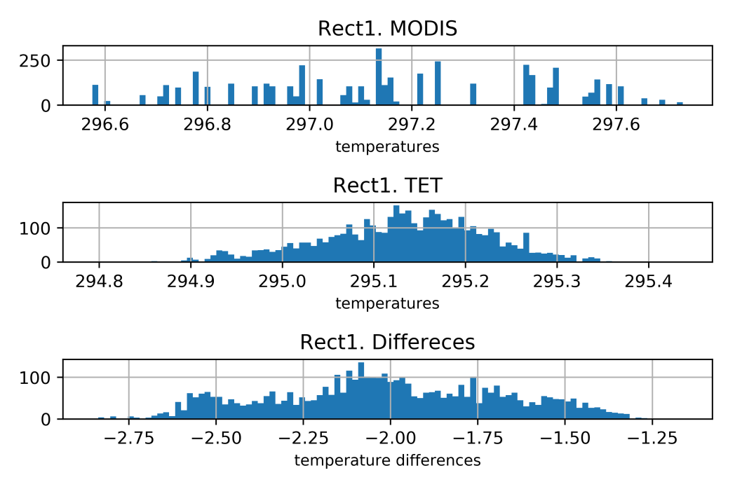
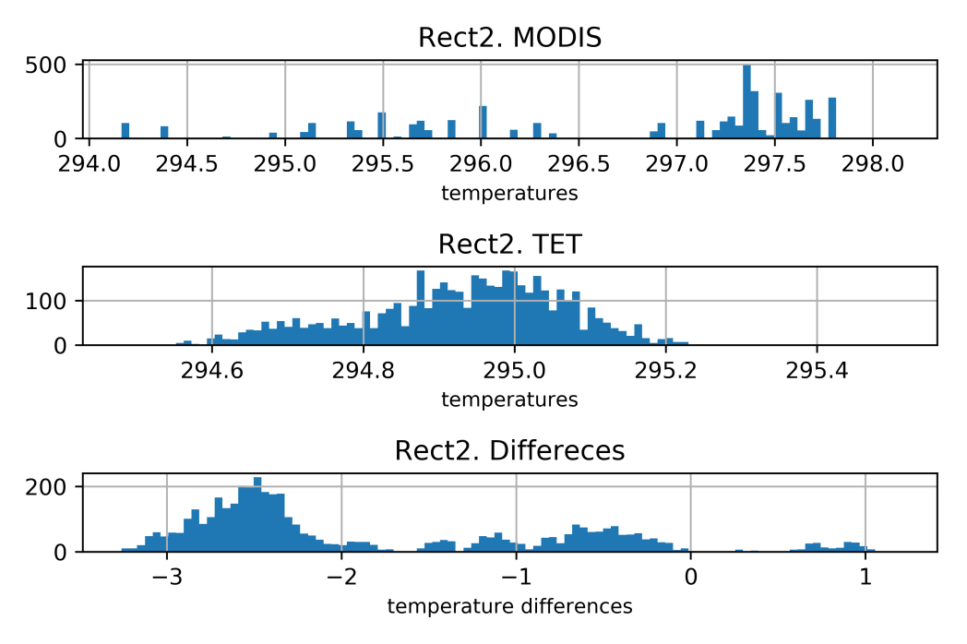
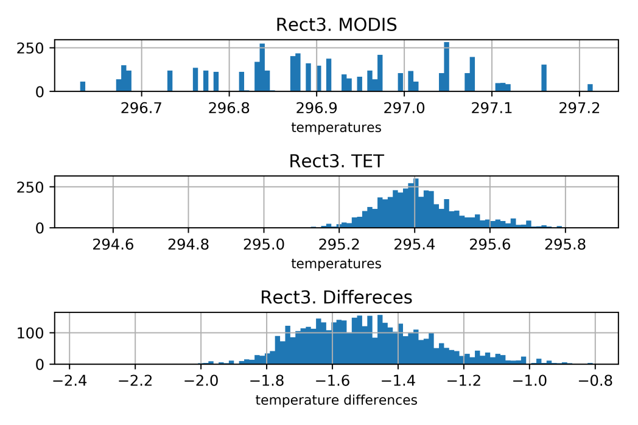
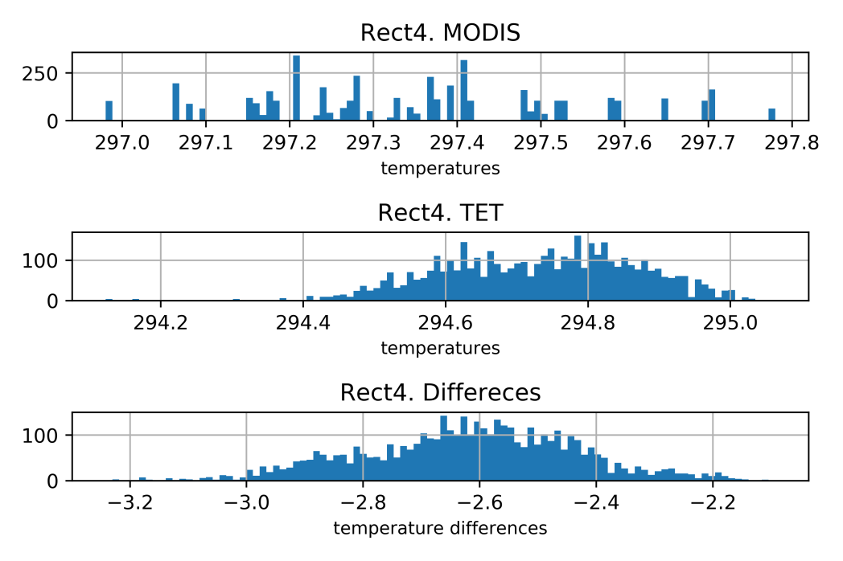
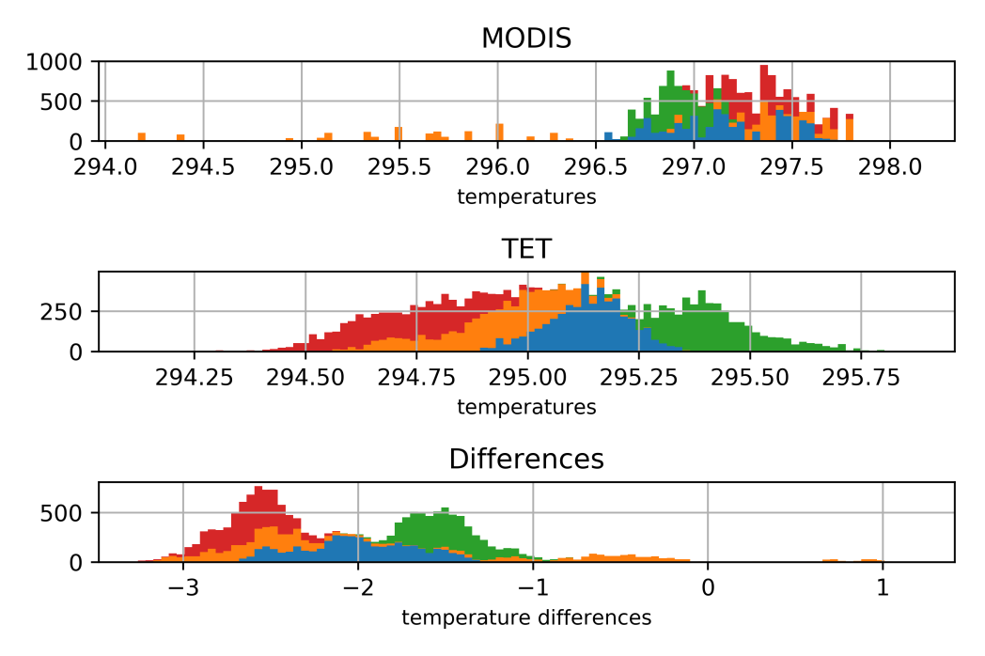
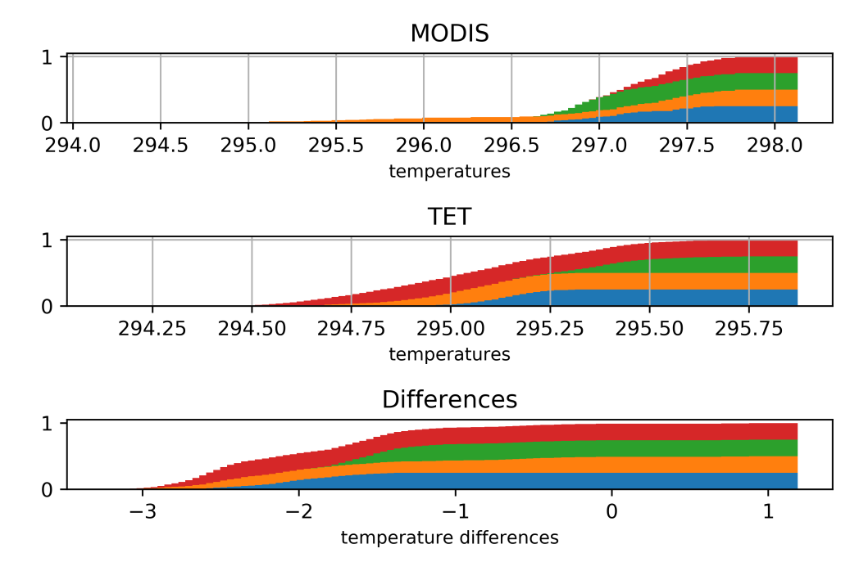
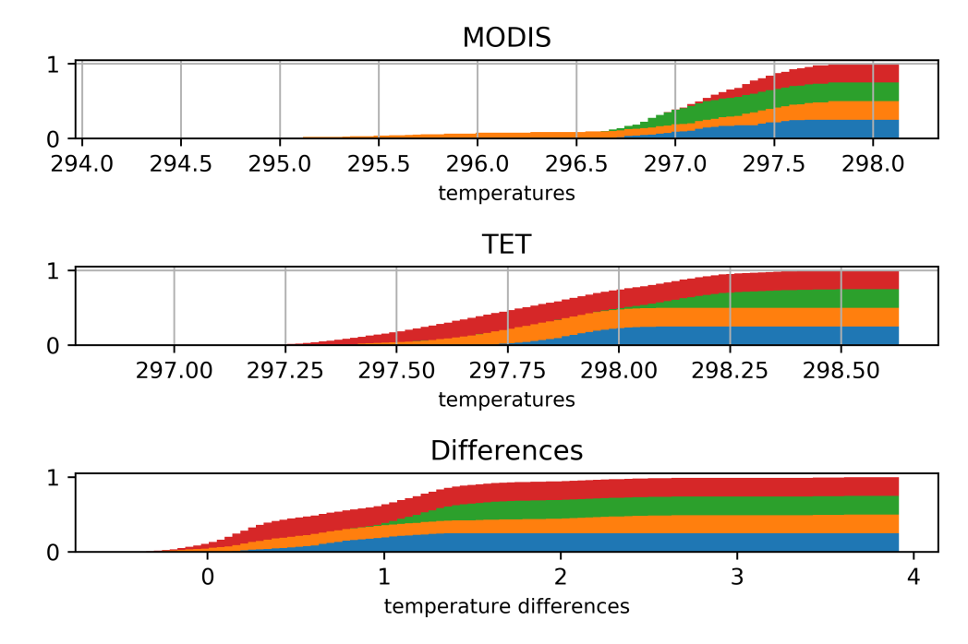


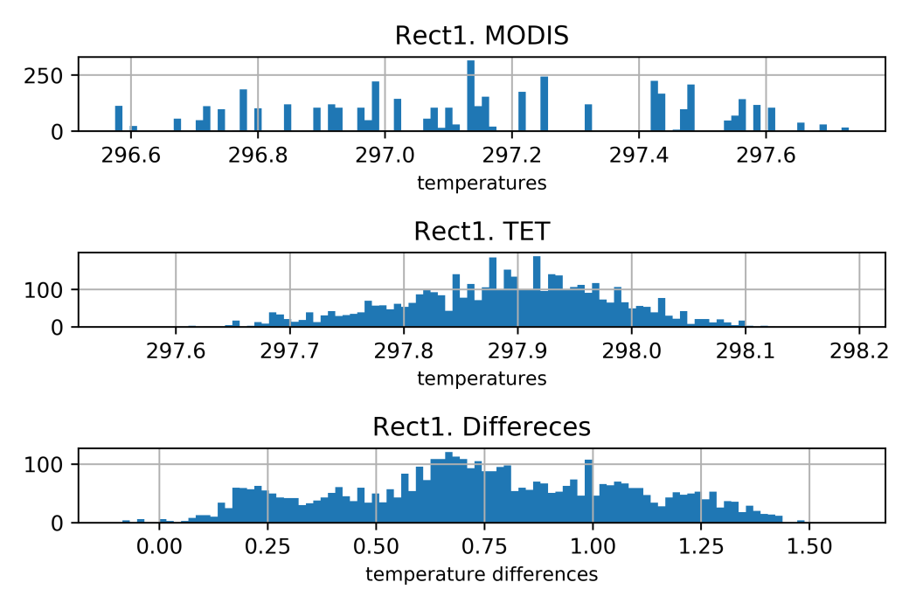
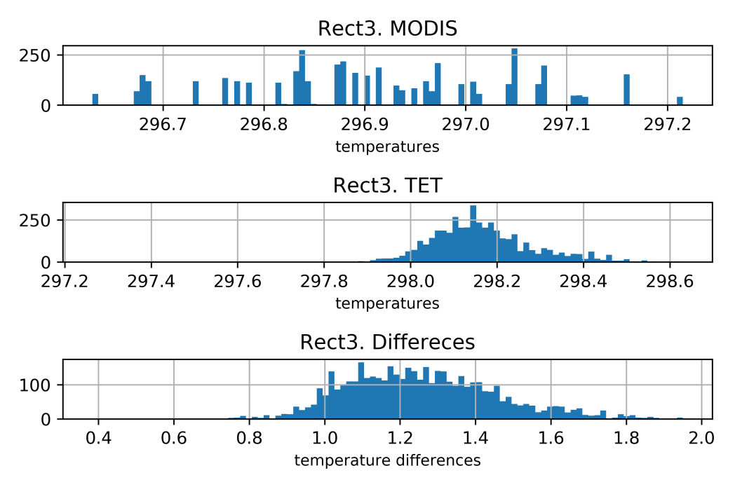
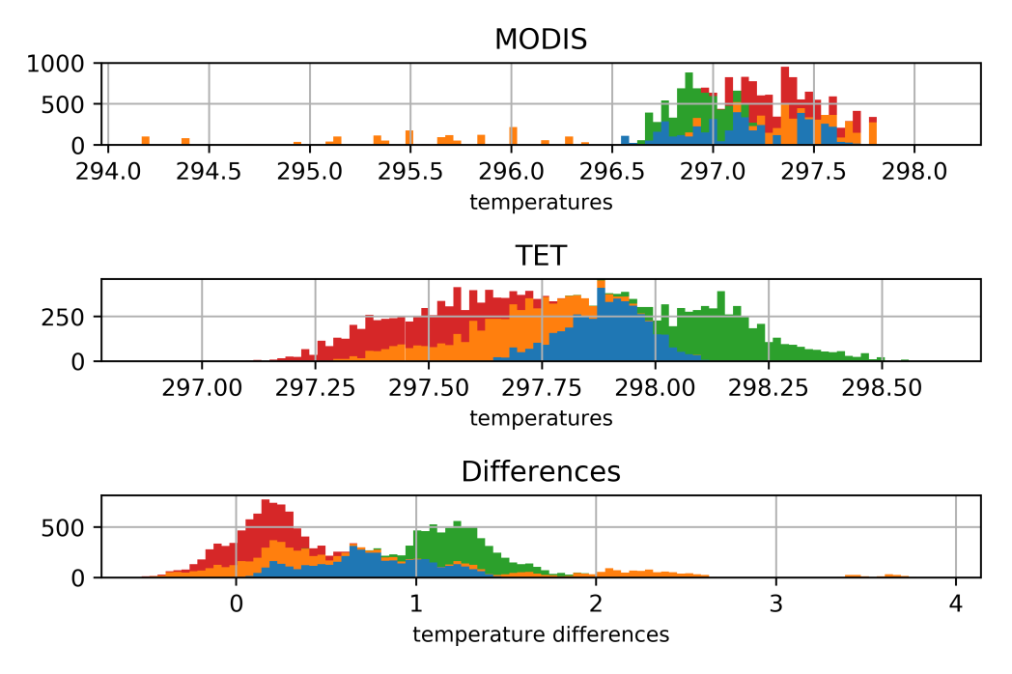
2.1 Results comparison with MODIS SST and calibration
Since the temperature derived by MITIP is a bit lower than the MODIS temperature products, we need to increase the TOA radiances. Here we selected five scale factors, namely 1.00 (original TOA radiances), 1.05 (increase the TOA radiances by 5%), 1.10, 1.15, 1.20, for each band and plot the histograms of the sub-areas to see how the scale factor effects the pixel values (temperature) of the imageries.
Here, we use the scene of 2014.06.22 and scale factor 1.00 and 1.10 as example.
Scale factor 1.00
Scale factor 1.10

Slide 25
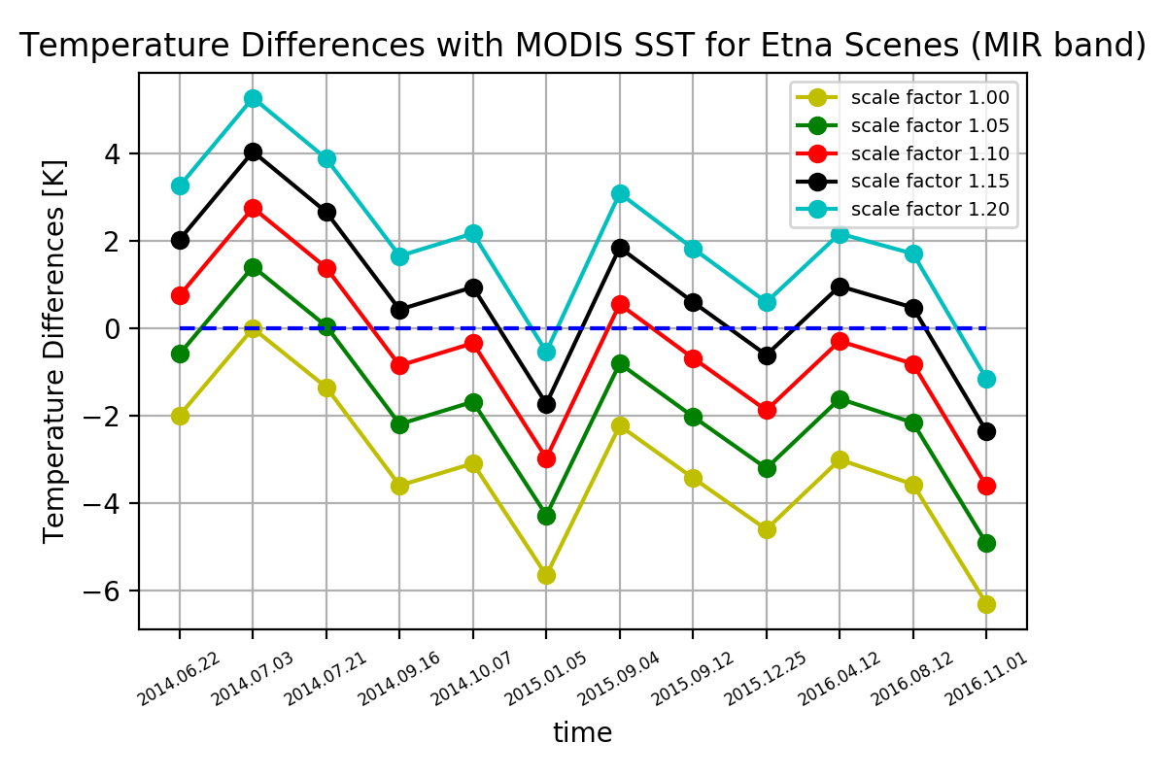
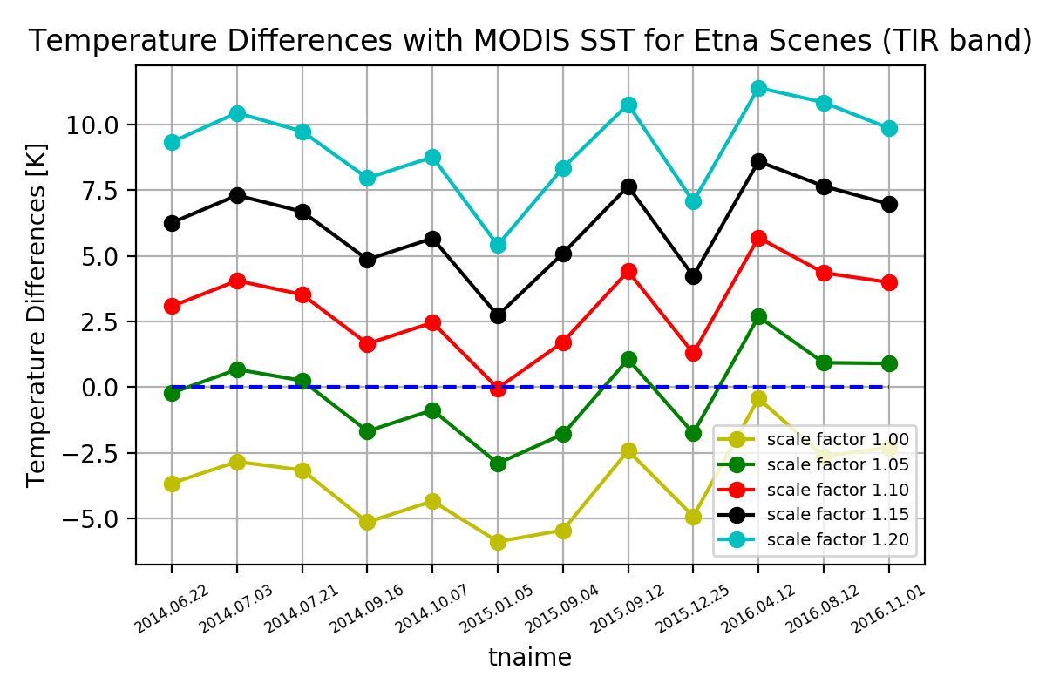
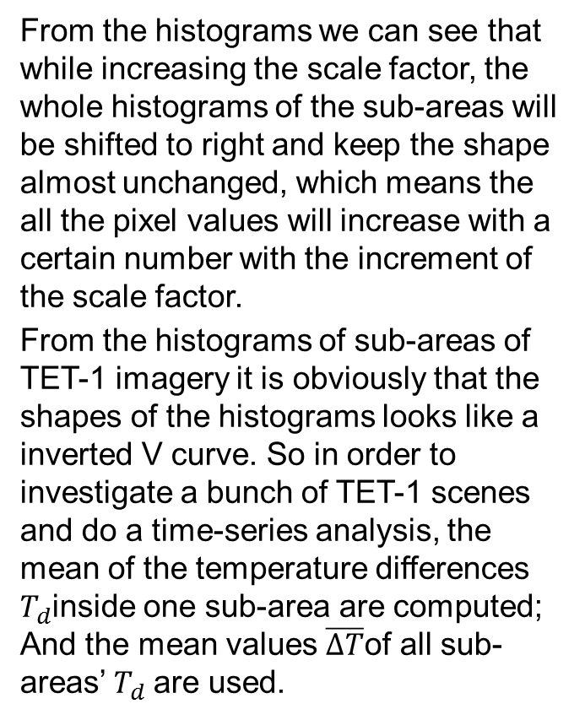
2.1 Results comparison with MODIS SST and calibration
From the histograms we can see that while increasing the scale factor, the whole histograms of the sub-areas will be shifted to right and keep the shape almost unchanged, which means the all the pixel values will increase with a certain number with the increment of the scale factor.
From the histograms of sub-areas of TET-1 imagery it is obviously that the shapes of the histograms looks like a inverted V curve. So in order to investigate a bunch of TET-1 scenes and do a time-series analysis, the mean of the temperature differences $T_{d}$inside one sub-area are computed; And the mean values $\overline{∆T}$of all sub-areas’ $T_{d}$are used.

Slide 26
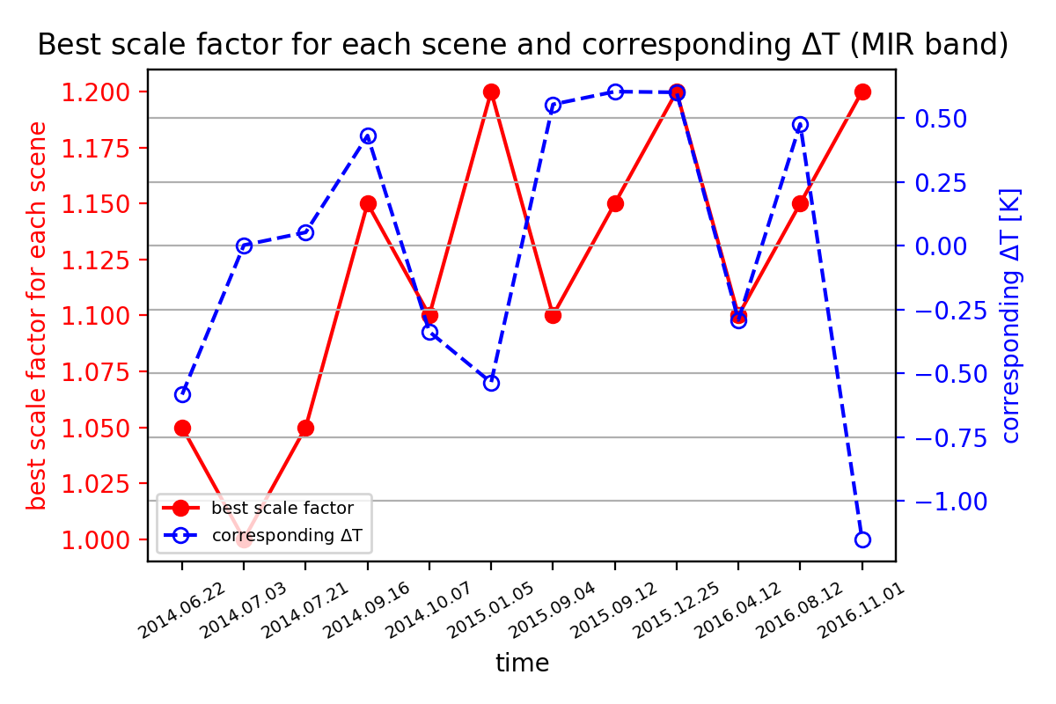
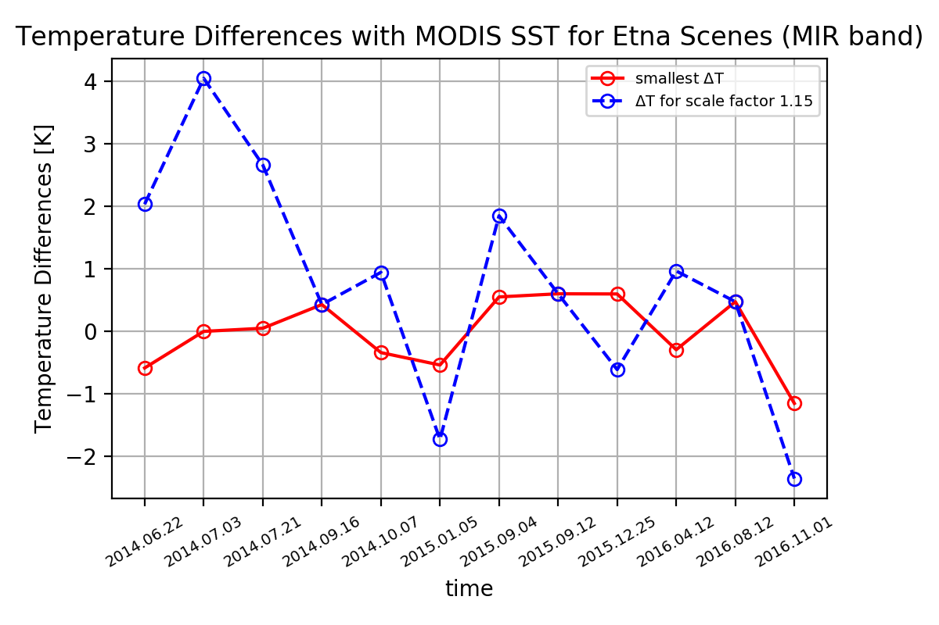
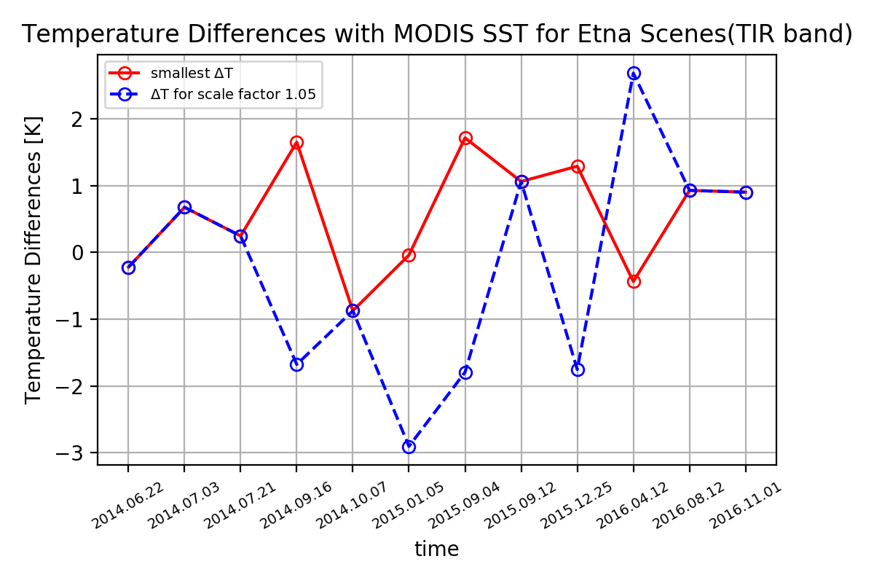
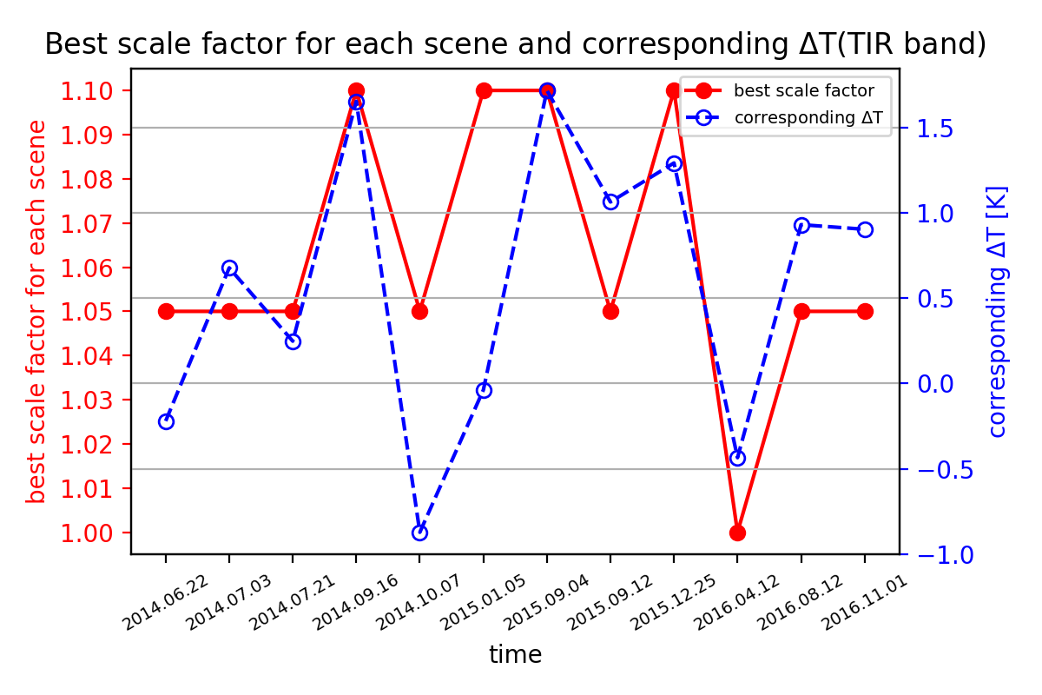

2.1 Results comparison with MODIS SST and calibration
The optimal scale factor for each band and its corresponding temperature difference $∆T$ is showed below.
According to the comparison results, the optimal scale factor for MIR band is chosen as 1.15 and for TIR band it is 1.05.

Slide 27
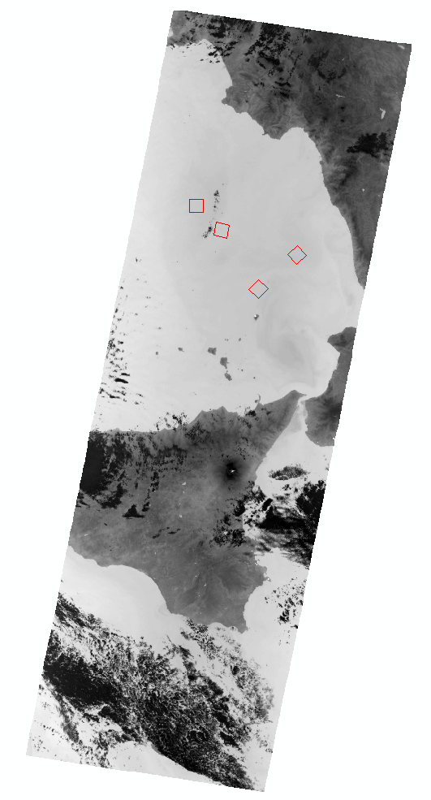
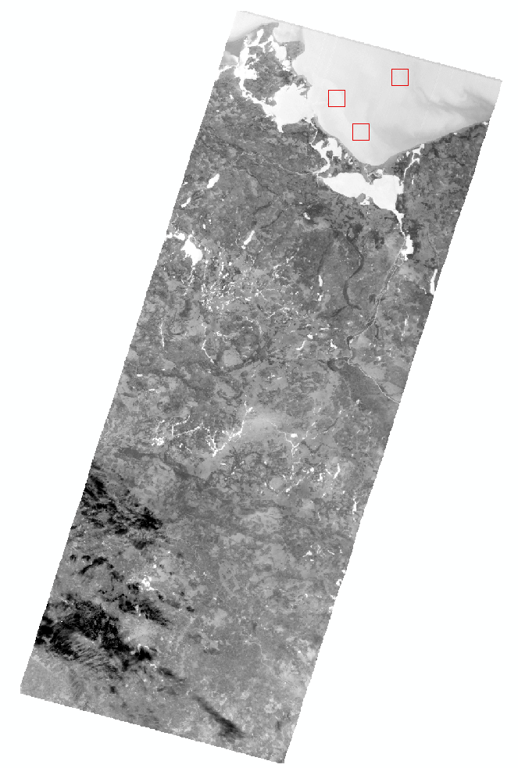
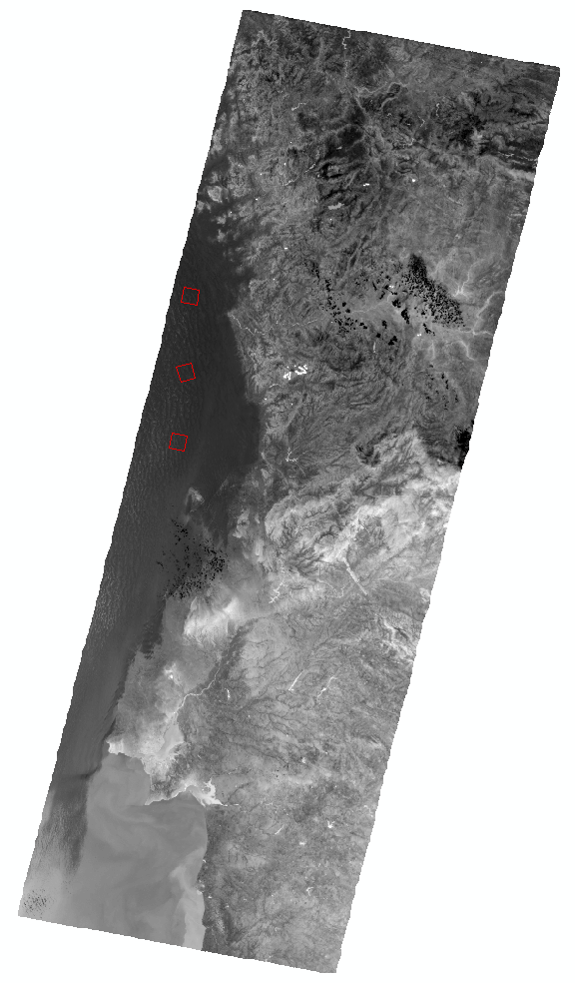
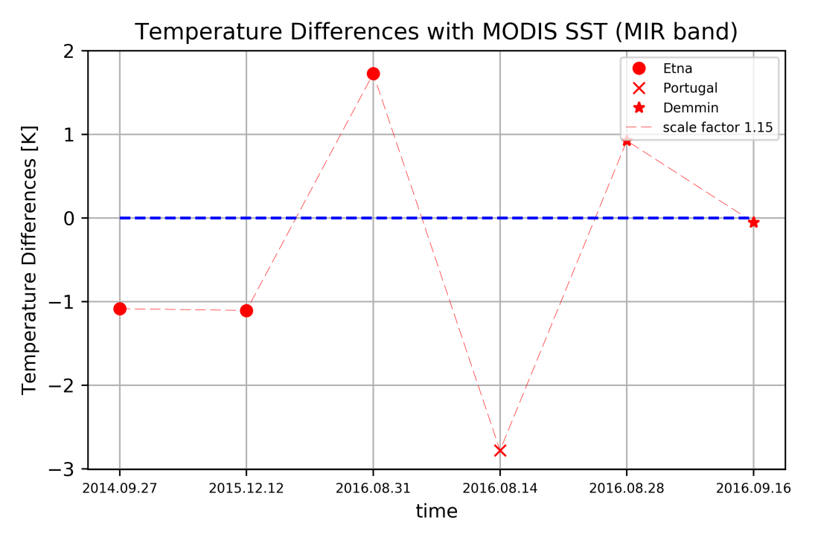



2.2 Transferability test (SST)
The chosen scale factor should be tested with different TET-1 imageries. Here, it is tested using scenes of Etna, Portugal and Demmin as showed bellow.

Slide 28





2.3 Results comparison with MODIS LST and calibration
The similar comparison is done between the temperature results from MITIP is compared with MODIS LST.
However, emissivities of different landscapes vary a lot as showed bellow. So firstly we need to choose which emissvity map should be used.
With the experiences of the comparison with MODIS SST, here scale factors 1.15 for MIR band and 1.05 for TIR band are used as standard.

Slide 29



2.3 Results comparison with MODIS LST and calibration
Similarly, several sub-areas are chosen to do the comparison as showed in the picture on the right.
And different scale factors (1.00, 1.05, 1.10, 1.15, 1.20) are used to see the differences between the temperature results from MITIP is compared with MODIS LST. The results are showed on the right.

Slide 30





2.3 Results comparison with MODIS LST and calibration
We can see that this situation is very similar with the comparison with the MODIS SST. The optimal scale factor for each band and its corresponding temperature difference $∆T$ is showed below.
According to the comparison results and to keep consistence, the optimal scale factor for MIR band is chosen as 1.15 and for TIR band it is 1.05 as well.

Slide 31





2.4 Transferability test (LST)
The chosen scale factor would be tested with different TET-1 imageries. Here, it is tested using scenes of Libya-2.

Slide 32
3. Analysis of high-temperature events
After the analysis of the performances of MITIP under the normal-temperature environments and the improvement of it, we get optimal scale factor for MIR band and TIR band respectively.
Now, we are able to analyse the performances of MITIP on the monitoring of high-temperature events (HTE).

Slide 33







3.1 High-temperature events
Etna and Stromboli

